Slide 1
The Breastfeeding and EArly Child Health (BEACH) Study
Dominick Lemas, PhD, CLC
Health Outcomes & Biomedical Informatics
University of Florida College of Medicine

Slide 2
DATA inventory
Over-Arching Goal
The goal of this presentation is to provide an overview of data entry and data inventory for the BEACH study.
Data Types
Electronic Health Records (EHR)
Biological Samples
E.g., urine, saliva, stool, breast milk
(Collected from mom and baby, at different points during study)
Self-Reported Data
General questionnaires
Phone interviews
Emails
Data inventory (?)
Clinic Visit Data (CRC Data)
Visit Date
Participant ID
Barcodes (for tubes)
Sample type
Regulatory and Admin
Incentives (gift cards, cookies?)
IRB
Specific Aims
Provide overview of data entry
Provide overview of data inventory

Slide 3
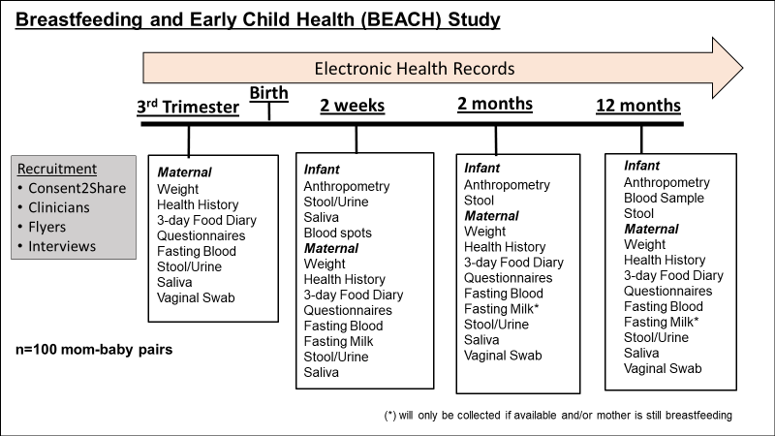
 | NW (BMI<25) | Ob (BMI>30)
VG (Vaginal) | 25 | 25
CS (C-section) | 25 | 25

Slide 4





engagement
qualitative study
clinical study
Lemas Lab Overview
Biospecimens
Electronic Health Records
Self-reported
Clinic Visit Data (CRC Data)
Regulatory and Admin
computing analysis
lab processing
Notes:
Population: This section of our workflow constitutes getting involved within the communities and informing potential participants of the study. Additionally, we involve ourselves within networking with the community and other organizations to try and expand our study. The final goal of our study is the dissemination of our collected information on pediatric obesity to the community.
Clinical: During our clinical section we begin by having a study visit of the mother where we ask them to answer some documents that provide us with valuable data. These visits are the same as pre and post natal health visits and provide the mother a time to review their health. We additionally collect Biological samples at certain times within the pregnancy and post pregnancy outlined by the longitudinal study section.
Lab: Within the lab we take collected samples and archive them within the lab and make sure that proper procedures are taken to avoid potential PHI (protected Heath information) leaks. We also preform test on collected samples and also outsource sample processing to other labs such as SECSUM. We also use certain Data bases to correctly archive and track the functions of the lab day to day.
Computation: During this section of the workflow we take processed data and analyze it. Before we can analyze the data we have the create a computational workflow that the data will be processed through. This allows us to create an efficient process through which the processed data can be passed through and provide us with significant information that we can then review foe analysis. We primarily do this through the hipergator, R programing, and other statistical and metabolomic based platforms.

Slide 5











Electronic Health Records
Other EHR
(continued on next page)
1. Request via fax
1. Gain access to Epic (Magda)
1. Check websites for medical release
2. Call about status of request
2. Extract data variables from Epic for RedCap upload*
2. Contact to obtain records
3. Receive PDF via mail
4. Extract data from PDF and import to Redcap
* Refer to EPIC training section
Version 3

Slide 6
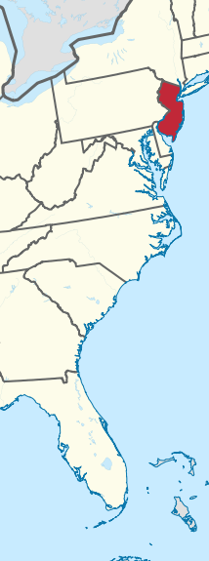
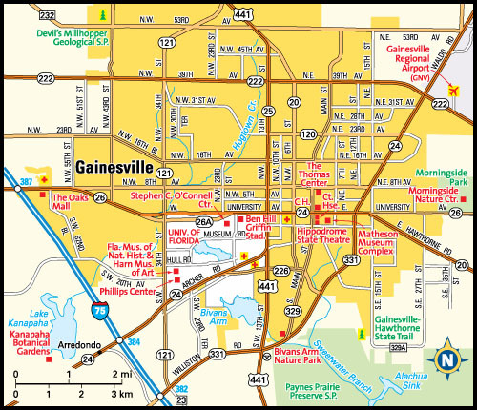
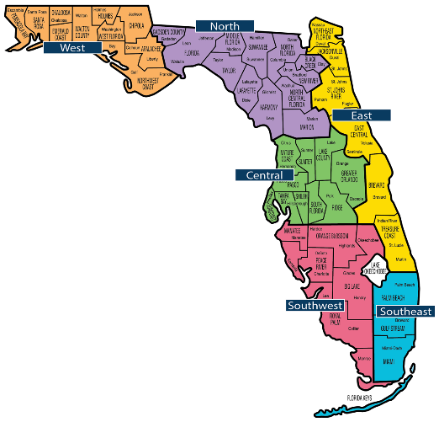


Other EHR:
Mom Healthcare
UF Health (20, 6•)
North Florida (1, 1•)
---
Dr. Nadkarni (1)
Family Practice Association (1)
Simed Health (5)
Dr. Janosk (Orlando) (1•)
Juternal Medical (Tower Hill) (1)
Monroe Medical Centre (Tallahassee) (1)
Hampton Oaks (1)
Physicians of North Brunswick (NJ) (1•)
Gainesville Internal Medicine (1•)
Comprehensive Women’s Health (1•)
Version 1

Slide 7

Other EHR:
Infant Delivery, Healthcare
Delivery:
UF Health (15, 4•)
North Florida (9, 3•)
---
Homebirth (3)
Alliance (1)
Birth and Wellness Center of Gainesville (1)
Healthcare:
UF Health (17, 3•)
North Florida (3, 3•)
---
Alliance (3, 1•)
Magnolia Park (2)
Healthy Steps (3, 3•)
Pediatric Associates (1)
Version 1

Slide 8
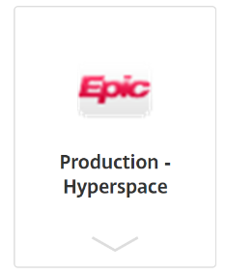



Epic Training Instructions - access
1. Download EPIC Production – Hyperspace from Citrix Receiver*
2. Open file, log into Epic
3. Select “Staff Message” to view set of participants
*may be identified by name, found in “Follow-up Survey” on RedCap or “BEACH Phone Screen”
*first time Citrix access - https://info.apps.ufl.edu/frequently-asked-questions/first-time-use/access-ufapps-from-a-pc/
Version 1
Notes:
Study preparation – obtaining consent, preparing and mailing out sample kits
Receiving kits - receiving home sample kits, collecting samples in lab (e.g., blood, anything not able to be collected from home)
Processing samples - archiving, freezing, data generation/entry
Data analyzing - taking data from biosamples

Slide 9
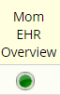
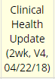
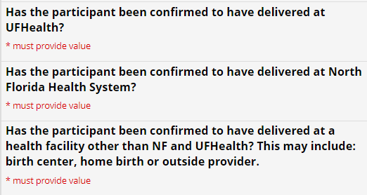
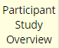

Epic Training Instructions – MOM EHR
1. Open Mom EHR Overview (under Baseline)
2. Enter self-reported delivery date (found in RedCap, 2 week Clinical Health Update)
3. Check Participant Study Overview (under Baseline) instrument for patient delivery location
4. Check boxes in Mom EHR relating to delivery location
5. Continue onto next slides only if delivered at UF Health
Version 1
Notes:
Study preparation – obtaining consent, preparing and mailing out sample kits
Receiving kits - receiving home sample kits, collecting samples in lab (e.g., blood, anything not able to be collected from home)
Processing samples - archiving, freezing, data generation/entry
Data analyzing - taking data from biosamples

Slide 10


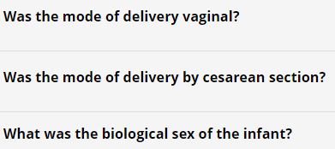
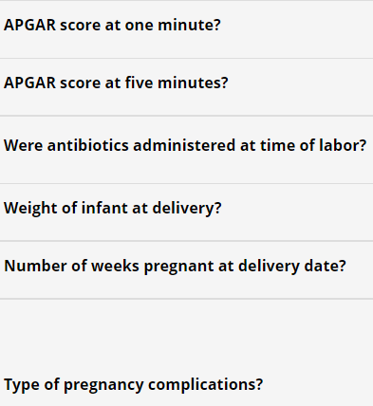
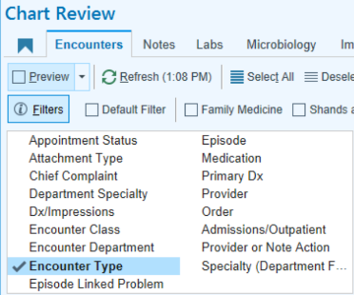
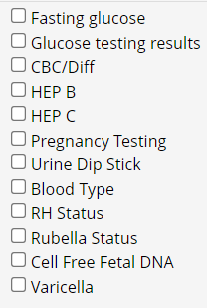


Epic Training Instructions – MOM EHR Cont.
6. Look up participant name on EPIC and pull up their Electronic Health Record
7. Check for Labor & Delivery (L&D) note, if none then you will need to look up variables independently or find other records entered on delivery date
8. Enter relevant fields: mode of delivery, biological sex APGAR scores, antibiotics, weight of infant, gestational age of mother, and prenatal complications (if any)
9. Filter for Encounter Type under Encounters tab to determine # prenatal encounters, then select Initial Prenatal and Routine Prenatal
12. Look up each lab measure and enter into RedCap if they were collected during pregnancy
11. Enter maternal blood type
10. Record number of prenatal encounters
Version 1
Notes:
How to submit 3 questions on side/where to find – labor and delivery notes

Slide 11

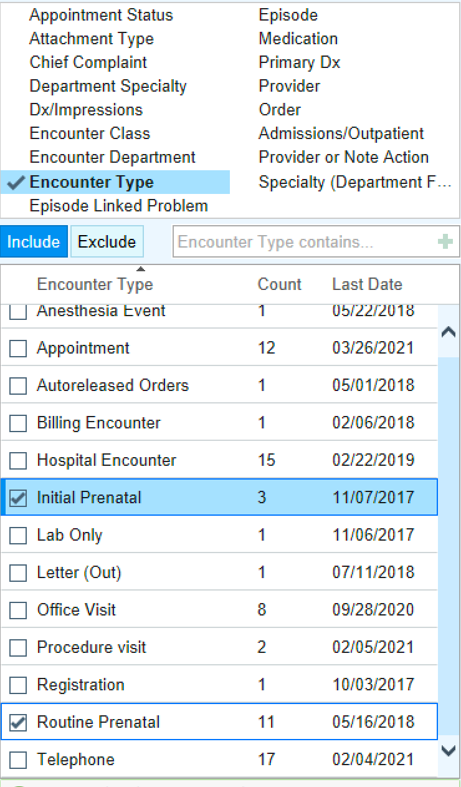

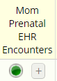
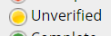

Epic training instructions – Mom prenatal ehr encounters
1. If patient delivered at UF Health, go to participant on Epic and be in “Chart Review”
2. Filter to Encounter Type, then Initial and Routine Prenatal
3. Click on description tab and organize by gestational age
4. Add details in RedCap fields, should be visible in Epic under report viewer page after selecting an encounter date
5. Include any additional notes at bottom that might not be evident from other variables included
7. Save and add a new instance until you inputted all encounters for that participant
6. Mark form as unverified
Version 1
Notes:
Study preparation – obtaining consent, preparing and mailing out sample kits
Receiving kits - receiving home sample kits, collecting samples in lab (e.g., blood, anything not able to be collected from home)
Processing samples - archiving, freezing, data generation/entry
Data analyzing - taking data from biosamples

Slide 12


Epic training instructions – Mom UF Labs
1. If patient delivered at UF Health, go to participant on Epic and be in “Chart Review”
2. Click on labs tab under chart review for the patient
3. Filter to Encounter Type, then Initial and Routine Prenatal
4. Look at each test listed on RedCap and find them on Epic chart, input values
*some testing is optional and is not included on Epic
Version 1
Notes:
Why is filter needed

Slide 13
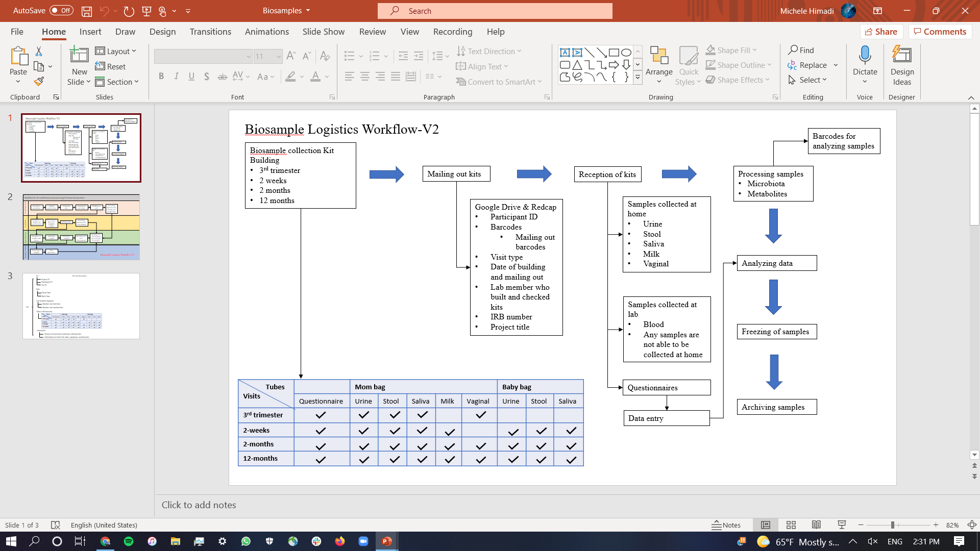



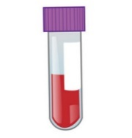




Biospecimens
2. Receive kits in clinic visit
- Collect blood and anything incomplete
1. Create and Mail Out Bio Sample Kits
3. Process and Store Biological Sample in CRC Freezer
E.g.:
Stool, blood
LemasLab
6. Data entry into RedCap
5. Archiving samples in Freezerworks
7. Data analysis
4. Transfer and Store Biological Sample in LemasLab Freezer
Version 4
Notes:
Fax cover letter with medical release signatures
Call to confirm fax was received
Follow up about status of mail
(Ideally) receive pages of prenatal records at Modular

Slide 14


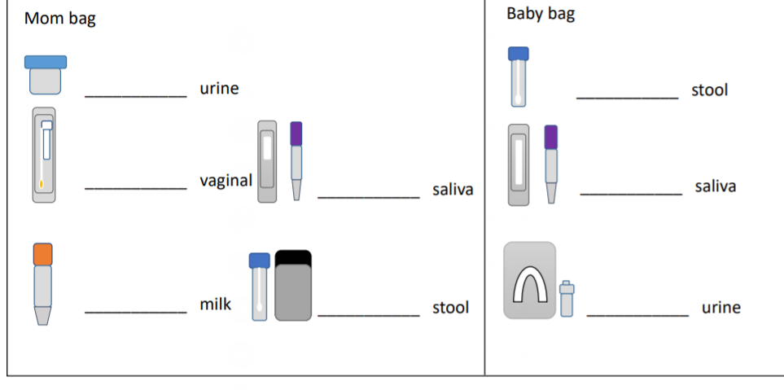

Biospecimens Kit
IDs: project, participant, kit
Signature: member who built, member who checked
Tubes with barcode
Date: build date, check date
Version 1
Notes:
Study preparation – obtaining consent, preparing and mailing out sample kits
Receiving kits - receiving home sample kits, collecting samples in lab (e.g., blood, anything not able to be collected from home)
Processing samples - archiving, freezing, data generation/entry
Data analyzing - taking data from biosamples

Slide 15






Self-Reported data
1. Patient makes clinic visit appointment
2. Several files collected/filled out at clinic visit*
Other visit notes collected
3. Files scanned into PDF
4. Files uploaded to Share Drive
Physical activity
Diet records
Subsocial
Health update
Infant feeding
Resilience
Exit survey
CTSI data
5. Ready for upload and RedCap entry
Version 1

Slide 16
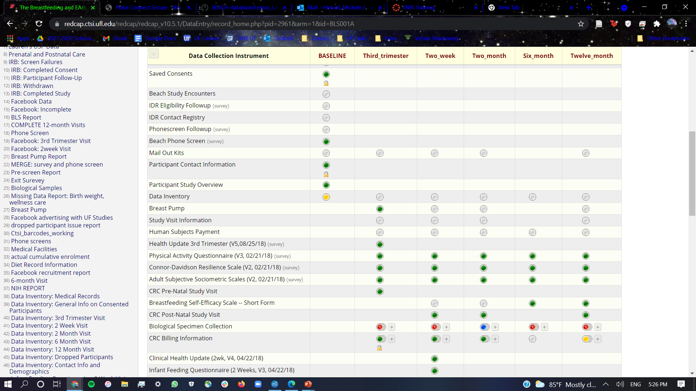

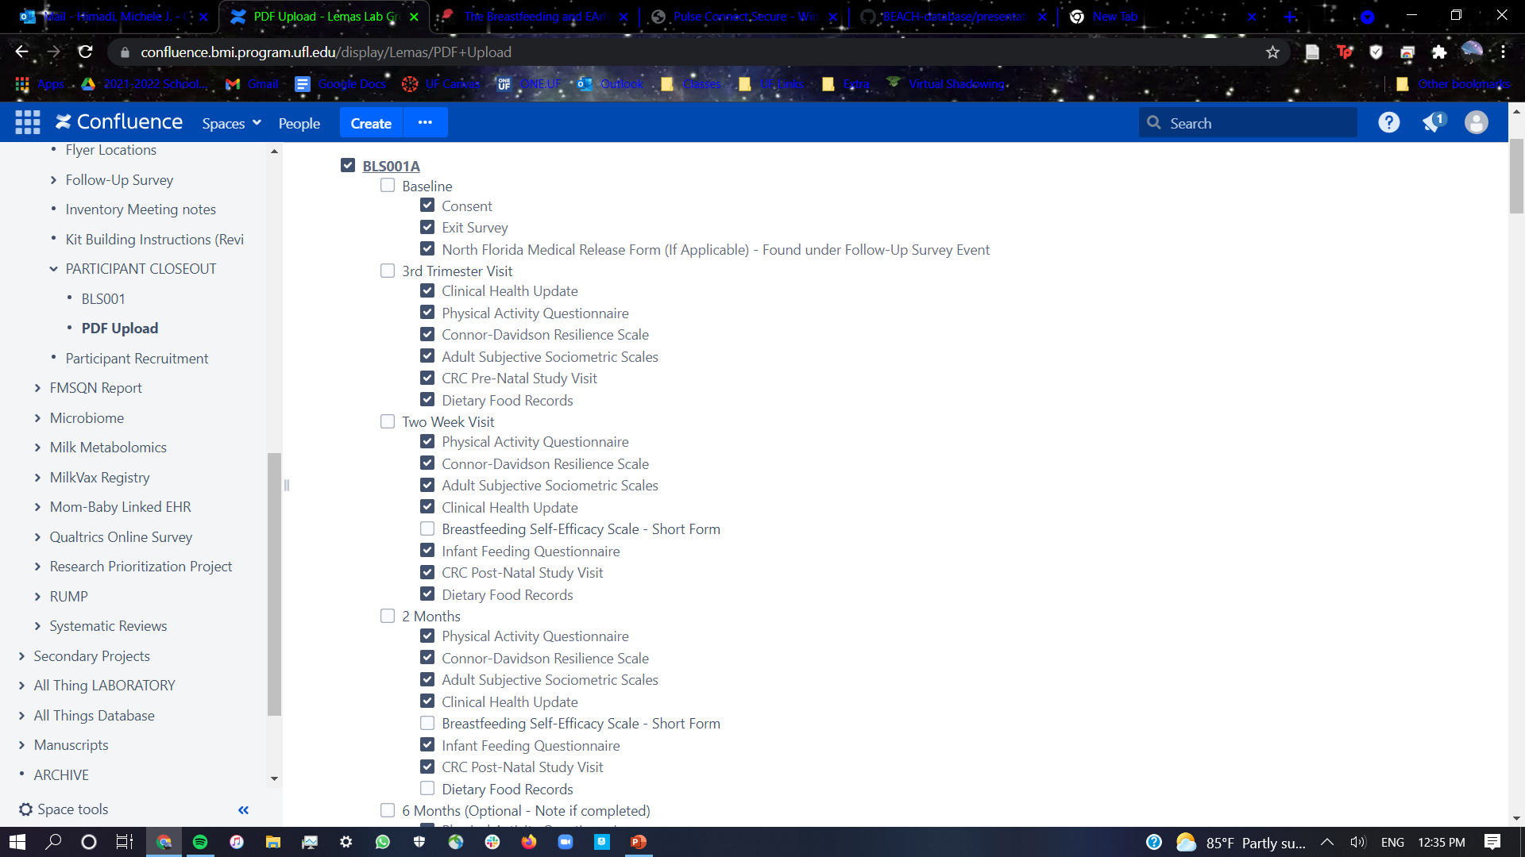

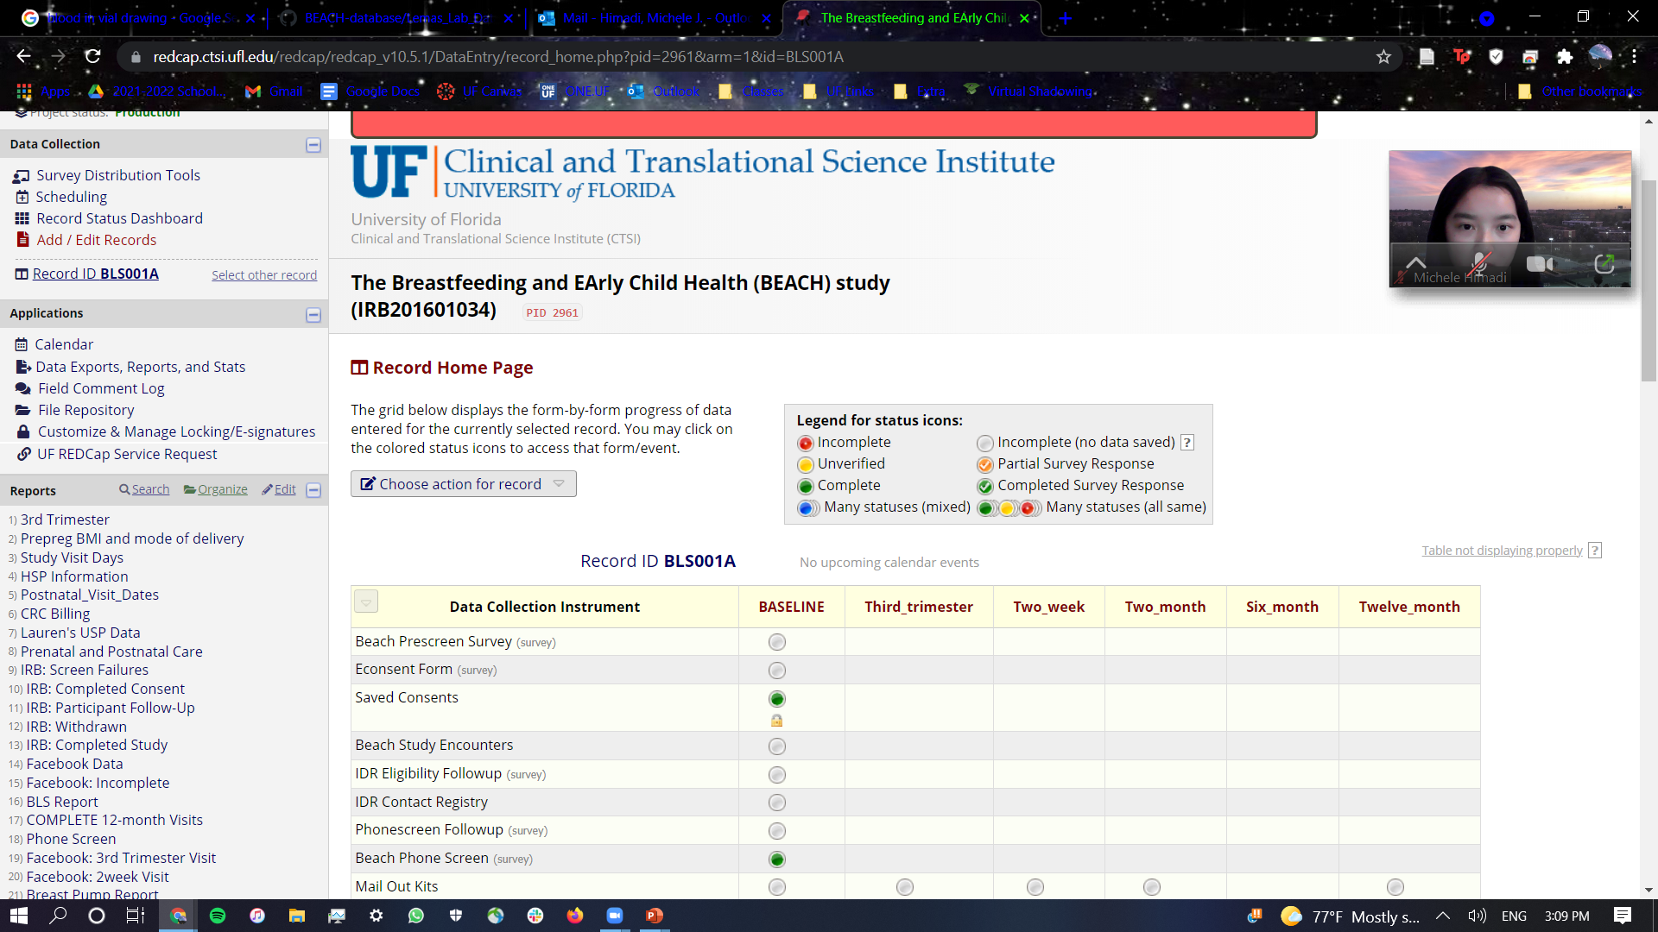





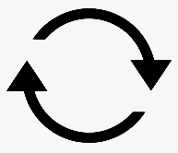
Redcap Entry
4. Download file to computer and upload to RedCap
3. Open ShareDrive and locate file
1. Check Confluence and Redcap for Participant Status
2. Select participant (e.g. BLS001) and locate unlocked or incomplete status
Data incomplete
5. Use file to complete data and mark for audit (Lock after audit)
Check for data completion
If data complete
(If no PDF in ShareDrive) check physical drive at CTSI (Magda)
5. Check over data
Lock, Delete File(s), and Repeat
Version 4

Slide 17
Regulatory and Admin (WIP)
Flyers have QR code for pre-screen (after that then phone-screen)
Before pt can come in, complete phone screening for eligibility
If not from UFHealth, pt brings in copy of medical records
Magda submits recorder (form on Beach study) to M.D. (signs off)
Submit clinic request appointment (Webcamp) via CTSI website
Appointment added on Outlook (Beach folder calendar)
Human subject payment (HSP) card, UF credit card, reloadable for every visit
Add money after each visit
Send birthday cards, “thank you for being in study cards” (students help, dept pays for mailing)

Slide 18
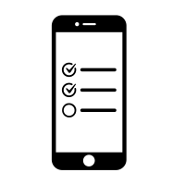


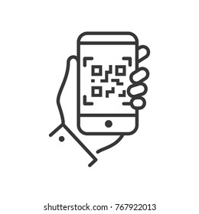


Regulatory and Admin
1. Flyers have QR code on them for study pre-screen
2. Participant completes phone screening
3. Participant comes in (with medical records if not from UF Health)
4. Magda submits recorder (study form) to M.D. to sign off so patient can participate
5. Participant submits clinic request appointment on Webcamp (CTSI), appointment added to Outlook
6. Human subject payment card given to subjects, reloaded with money after each visit
Version 1

Slide 19


Regulatory and Admin – Student assistance
Help with putting up flyers for BEACH study
Creating cards (holiday, birthday, thank you) and sending out cards to participants
Version 1

